Slide 1
Great Theorem: The Pythagorean Theorem
Euclid
Journey Through Genius Pp 48

Slide 2
The Proof of the Pythagorean Theorem
Unlike some of the other proofs in Elements this proof belonged solely to Euclid
We have seen the preceding 46 propositions, none touching on quadrilaterals (other than parallelograms), circles were not discussed, similarity isn’t touched on until Book VI -- the Pythagorean theorem can be proved easily using similar triangles, but Euclid did not want to wait until Book VI
This is the perfect finale for Book I, it has been building to this

Slide 3
Prop I.47: In right-angled triangles, the square on the side subtending the right angle is equal to the squares on the sides containing the right angle

Slide 4
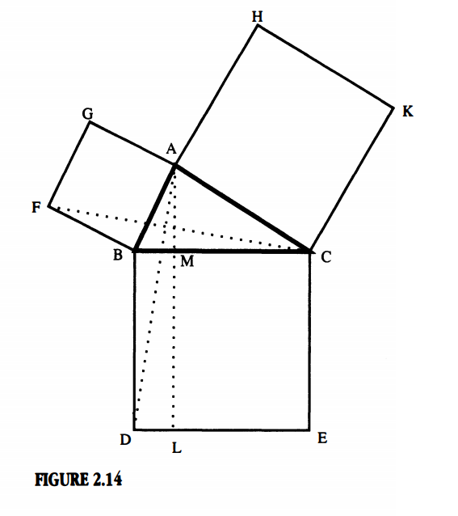
We will now examine the proof:

Slide 5
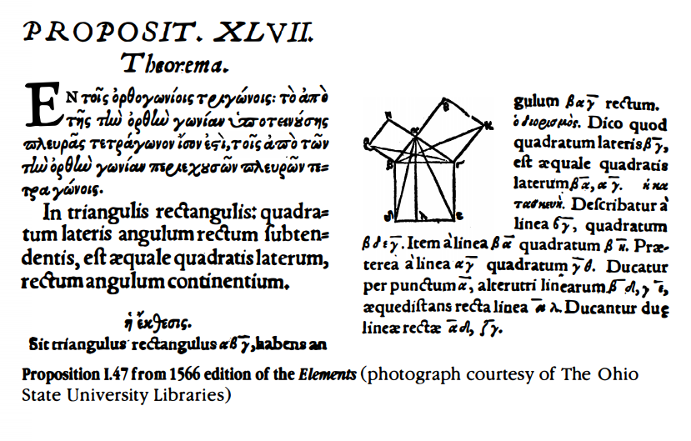

Slide 6
Euclid was not quite finished,
Prop I.48: If in a triangle the square on one of the sides be equal to the squares on the remaining two sides of the triangle, the angle contained by the remaining two sides of the triangle is right.
The final theorem he set out to prove was the converse of the Pythagorean Theorem

Slide 7
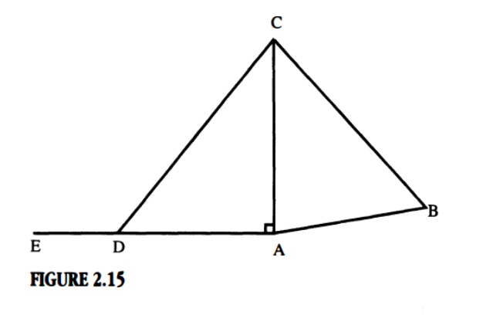
We will now examine the proof:

Slide 8
With this proposition, we have finished examining Book I of the Elements.

